Slide 1
STAT 240 Review
Prepared by: Cameron Jones
Created Fall 2023, Adapted for Fall 2024

Slide 2
Unit 2: Data Visualization

Slide 3
Unit 2: Data Visualization
Which of the following geometries require TWO variables? (choose all that apply)
geom_bar
geom_col
geom_histogram
geom_density
FA24

Slide 4
Unit 2: Data Visualization
Which of the following geometries require TWO variables?
geom_bar
geom_col
geom_histogram
geom_density
Explanation:
Geom_bar automatically counts and plots the occurrences of a single categorical variable.
Geom_histogram automatically “bins” and plots the counts of occurrences of a single numeric variable.
Geom_density automatically produces a smooth curve similar to a histogram encoding the number of occurrences of a single numeric variable.
FA24

Slide 5
Unit 2: Data Visualization
You wish to visualize the distribution of Temperature (continuous) within each of 12 months. Should you facet by Temperature or Month?
FA24

Slide 6
Unit 2: Data Visualization
You wish to visualize the distribution of Temperature (continuous) within each of 12 months. Should you facet by Temperature or Month?
Explanation: One should facet by the categorical variable Month. Faceting generates a plot for each unique value of a variable, so it should be applied to categorical variables only.
FA24

Slide 7
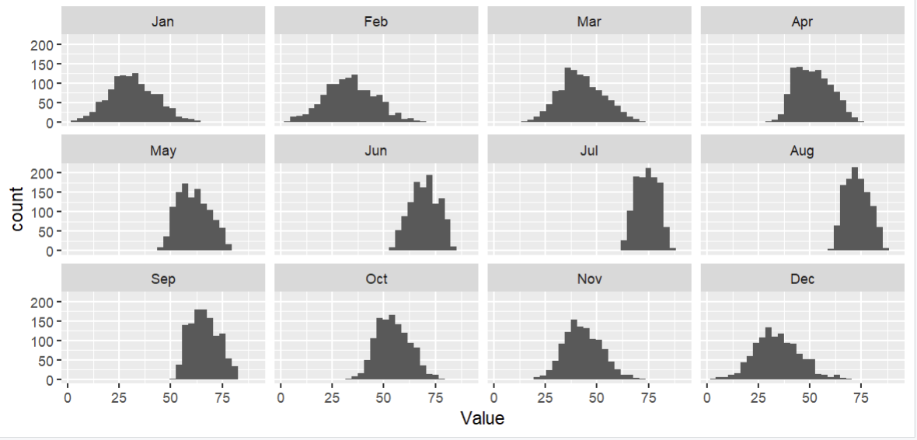
Unit 2: Data Visualization
Faceting Example
FA24

Slide 8
Unit 3: Dplyr

Slide 9
Unit 3: dplyr
Which of these commands may behave differently when preceded by group_by(something)? (choose all that apply)
select()
mutate()
slice_max()
summarize()
FA24

Slide 10
Unit 3: dplyr
Explanation: select() just keeps columns.
In mutate() and summarize(), expressions like mean() or n() will be evaluated at the group level if applicable, and over the entire dataframe otherwise.
Slice_max()with n=3 will give you 3 total rows without grouping, and 3 for each group with grouping
Which of these commands may behave differently when preceded by group_by(something)?
select()
mutate()
slice_max()
summarize()
FA24

Slide 11
Unit 3: dplyr
“myData” has 50 rows, and a categorical variable “group” which has 5 different values. How many rows will the result of this command have?
myData %>% group_by(group) %>% mutate(nRows = n())
FA24

Slide 12
Unit 3: dplyr
“myData” has 50 rows, and a categorical variable “group” which has 5 different values. How many rows will the result of this command have?
myData %>% group_by(group) %>% mutate(nRows = n())
Explanation: It will still have 50! mutate() always just adds a column, the group_by() only affects the values it puts in that column.
FA24

Slide 13
Unit 4: Joining + Pivoting

Slide 14
Unit 4: Joining + Pivoting
“df1” has 5 rows, and “df2” has 4 rows; they have a variable in common, and 3 rows each which would automatically match.
Rank the following by how many rows the resulting dataframe would have. (least -> most)
left_join(df1, df2)
Right_join(df1, df2)
Inner_join(df1, df2)
Full_join(df1, df2)
FA24

Slide 15
Unit 4: Joining + Pivoting
“df1” has 5 rows, and “df2” has 4 rows; they have a variable in common, and 3 rows each which would automatically match.
Rank the following by how many rows the resulting dataframe would have. (least -> most)
left_join(df1, df2)
Right_join(df1, df2)
Inner_join(df1, df2)
Full_join(df1, df2)
Explanation:
inner_join keeps all rows which match in both dataframes (3). Right_join keeps only the rows in the second dataframe (4). Left_join keeps only the rows in the first dataframe (5). Full_join keeps all rows in both frames (3 that match, 2 others from df1, 1 other from df2 = 6)
FA24

Slide 16
Unit 4: Joining + Pivoting
Which of these statements are true about applying pivot_longer to a dataframe? (choose all that apply)
It can decrease the number of rows from what it was before.
It can increase the number of rows.
It can decrease the number of columns.
It can increase the number of columns.
FA24

Slide 17
Unit 4: Joining + Pivoting
Which of these statements are true about applying pivot_longer to a dataframe? (choose all that apply)
It can decrease the number of rows from what it was before.
It can increase the number of rows.
It can decrease the number of columns.
It can increase the number of columns.
Explanation:
Pivot_longer() takes X columns and spreads them out across two columns and X rows. The dataframe gets longer vertically (more rows) and narrower horizontally (less columns).
The question is worded like this because if you only pivot two columns, the number of columns will technically stay the same.
FA24

Slide 18
Unit 4: Joining + Pivoting
myData currently has two rows for every U.S. state (100 total) (variable name state); one row representing the married people in that state, and one row representing non-married people, indicated by the variable marriageStatus. There is a column income which stores the average income of the people in that state-marriage combination. Write out the command which would transform myData into a dataframe with one row for every state, and a column each for avg. income among married and non-married people.
FA24

Slide 19
Unit 4: Joining + Pivoting
myData currently has two rows for every U.S. state (100 total) (variable name state); one row representing the married people in that state, and one row representing non-married people, indicated by the variable marriageStatus. There is a column income which stores the average income of the people in that state-marriage combination. Write out the command which would transform myData into a dataframe with one row for every state, and a column each for avg. income among married and non-married people.
myData %>% pivot_wider(
names_from = marriageStatus, values_from = income)
We want to take the two rows for each state, defined by marriageStatus, and pivot them wider into one row for each state with two columns; the names of those columns will represent married & non-married respectively, and their values will come from the old income column.
FA24

Slide 20
Unit 5: Basic Probability Theory

Slide 21
Unit 5: Basic Probability Theory
Fill in the blank to make this a valid probability distribution.
X | 1 | 2 | 3 | 4 | 5
P(X=x) | 0.1 | ? | 0.3 | 0.3 | 0.1
FA24

Slide 22
Unit 5: Basic Probability Theory
Solution: The sum of the probabilities in a discrete distribution must be 1.
X | 1 | 2 | 3 | 4 | 5
P(X=x) | 0.1 | 0.2 | 0.3 | 0.3 | 0.1
FA24

Slide 23
Unit 5: Basic Probability Theory
Write down an expression (no need to simplify) for the mean of the following probability distribution.
X | 1 | 2 | 3 | 4 | 5
P(X=x) | 0.1 | 0.2 | 0.3 | 0.3 | 0.1
FA24

Slide 24
Unit 5: Basic Probability Theory
Write down an expression for the mean of the following probability distribution.
Explanation:
(1 * 0.1) + (2 * 0.2) + (3 * 0.3) + (4 * 0.3) + (5 * 0.1). The mean of a (discrete) probability distribution is found by multiplying every possible value of X by its probability, and summing those products up.
X | 1 | 2 | 3 | 4 | 5
P(X=x) | 0.1 | 0.2 | 0.3 | 0.3 | 0.1
FA24

Slide 25
Unit 5: Basic Probability Theory *
Find the cumulative probability at each x (the CDF).
X | 1 | 2 | 3 | 4 | 5
P(X=x) | 0.1 | 0.2 | 0.3 | 0.3 | 0.1
X | 1 | 2 | 3 | 4 | 5
P(X<=x) | ? | ? | ? | ? | ?
FA24

Slide 26
Unit 5: Basic Probability Theory *
Find the cumulative probability at each x (the CDF).
X | 1 | 2 | 3 | 4 | 5
P(X=x) | 0.1 | 0.2 | 0.3 | 0.3 | 0.1
X | 1 | 2 | 3 | 4 | 5
P(X<=x) | 0.1 | 0.3 | 0.6 | 0.9 | 1
FA24

Slide 27
Unit 5: Basic Probability Theory
Find the cumulative probability at each x (the CDF).
X | 1 | 2 | 3 | 4 | 5
P(X=x) | 0.1 | 0.2 | 0.3 | 0.3 | 0.1
X | 1 | 2 | 3 | 4 | 5
P(X<=x) | 0.1 | 0.3 | 0.6 | 0.9 | 1
FA24

Slide 28
Unit 5: Basic Probability Theory
Find the cumulative probability at each x (the CDF).
X | 1 | 2 | 3 | 4 | 5
P(X=x) | 0.1 | 0.2 | 0.3 | 0.3 | 0.1
X | 1 | 2 | 3 | 4 | 5
P(X<=x) | 0.1 | 0.3 | 0.6 | 0.9 | 1
FA24

Slide 29
Unit 5: Basic Probability Theory
What is the 0.8 quantile of this distribution?
X | 1 | 2 | 3 | 4 | 5
P(X<=x) | 0.1 | 0.3 | 0.6 | 0.9 | 1
Notice: still cumulative probability, not pointwise
FA24

Slide 30
Unit 5: Basic Probability Theory
What is the 0.8 quantile of this distribution?
X | 1 | 2 | 3 | 4 | 5
P(X<=x) | 0.1 | 0.3 | 0.6 | 0.9 | 1
Explanation: 4 is the first X value which achieves AT LEAST 0.8 cumulative probability, so it is the 0.8 quantile. It is also the p-quantile for all p greater than 0.6 up to and including 0.9.
FA24

Slide 31
Unit 6: Binomial & Normal Distributions

Slide 32
Unit 6: Binomial & Normal Distributions
Consider bowling a ball at ten bowling pins, and let X be the total number of pins knocked down.
Does X follow a binomial distribution? Why or why not?
FA24

Slide 33
Unit 6: Binomial & Normal Distributions
Consider bowling a ball at ten bowling pins, and let X be the total number of pins knocked down.
Does X follow a binomial distribution? Why or why not?
Explanation:
No. All four assumptions must be met for X to be Binomial, and at least one is not met.
B: Binary outcome. This is assumption is valid: every pin either falls (success) or doesn’t (failure).
I: Independence. This assumption is NOT valid. One pin being knocked over is more likely to knock over other pins; you can’t, for example, just knock over the back left and back right pin and nothing else.
N: Fixed number of trials. This assumption is valid; there are exactly 10 pins.
S: Same probability for each trial. Does each pin have the same likelihood of being knocked down? Maybe, but probably not. This one is debatable.
FA24

Slide 34
Unit 6: Binomial and Normal Distributions
Let X ~ Binom(n, p).
Which of the following returns P(1 < X <= 4)?
pbinom(4, n, p) – pbinom(1, n, p)
pbinom(5, n, p) – pbinom(0, n, p)
pbinom(4, n, p) – pbinom(2, n, p)
pbinom(3, n, p) – pbinom(1, n, p)
FA24

Slide 35
Unit 6: Binomial and Normal Distributions
Let X ~ Binom(n, p).
Which of the following returns P(1 < X <= 4)?
pbinom(4, n, p) – pbinom(1, n, p)
pbinom(5, n, p) – pbinom(0, n, p)
pbinom(4, n, p) – pbinom(2, n, p)
pbinom(3, n, p) – pbinom(1, n, p)
pbinom(x, n, p) gives P(Binom(n, p) <= x). We want the area under 4, 3, and 2 (1 not included). We take all the area under and to the left of 4, and subtract all the area under and to the left of 1.
FA24

Slide 36
Unit 6: Binomial & Normal Distributions *
True or False: These two commands will return the same value.
dbinom(0, size = 5, prob = 0.2)
pbinom(0, size = 5, prob = 0.2)
FA24

Slide 37
Unit 6: Binomial & Normal Distributions *
True or False: These two commands will return the same value.
dbinom(0, size = 5, prob = 0.2)
pbinom(0, size = 5, prob = 0.2)
Explanation:
True.
dbinom() gives P(X=x), and pbinom() gives P(X<=x), so generally not the same. But the binomial distribution can only go as low as 0 (all trials fail), so P(X=0) = P(X<=0) for binomial variables!
FA24

Slide 38
Unit 6: Binomial & Normal Distributions *
Write out R code which would compute P(35 <= X <= 50), where
X ~ Normal(40, 5).
FA24

Slide 39
Unit 6: Binomial & Normal Distributions *
Write out R code which would compute
P(35 <= X < 50), where
X ~ Normal(40, 5).
Explanation:
pnorm(50, 40, 5) – pnorm(35, 40, 5)
The first term is all the area to the left of 50; the second term is all the area to the left of 35. When you subtract the two, you are left with the area in between them. There is no need to adjust here – continuous areas, caution to the wind!
FA24

Slide 40
Unit 7: Linear Regression Intro

Slide 41
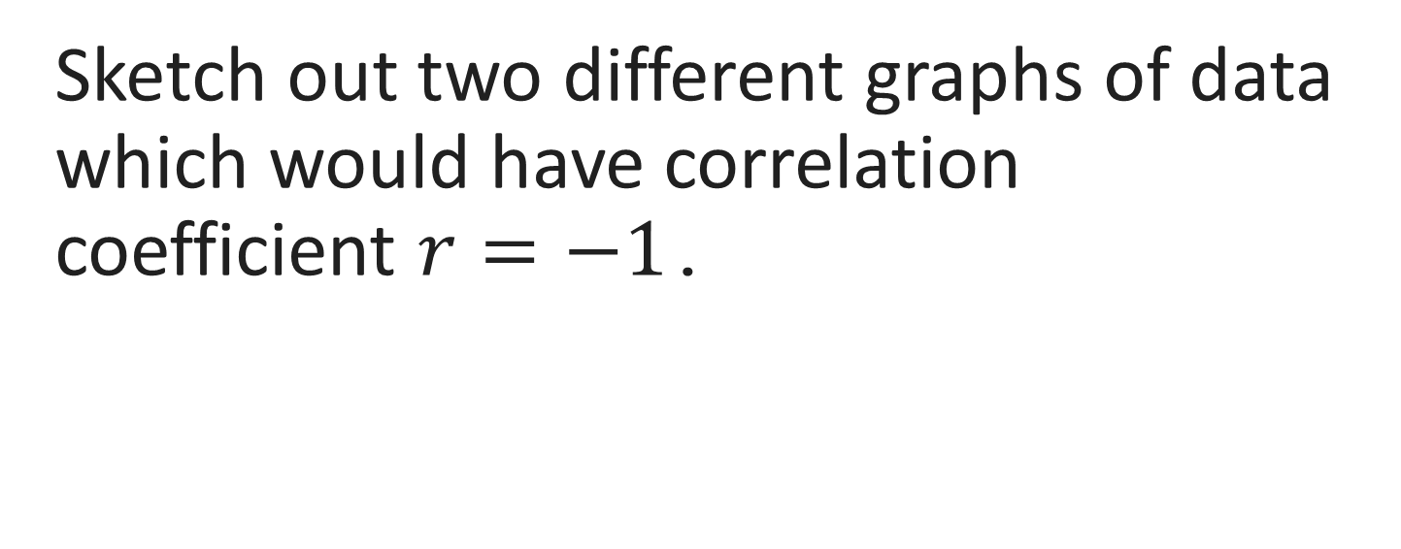
Unit 7: Linear Regression Intro *
Sketch out two different graphs of data which would have correlation coefficient $r=−1$.
FA24

Slide 42
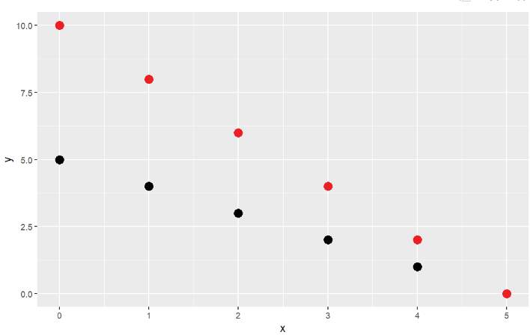
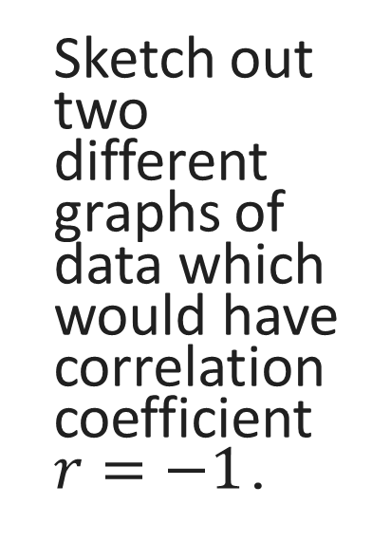
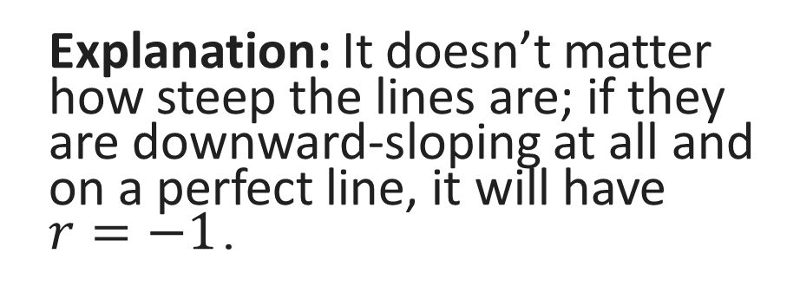
Unit 7: Linear Regression Intro *
Explanation: It doesn’t matter how steep the lines are; if they are downward-sloping at all and on a perfect line, it will have $r=−1$.
Sketch out two different graphs of data which would have correlation coefficient $r=−1$.
FA24

Slide 43
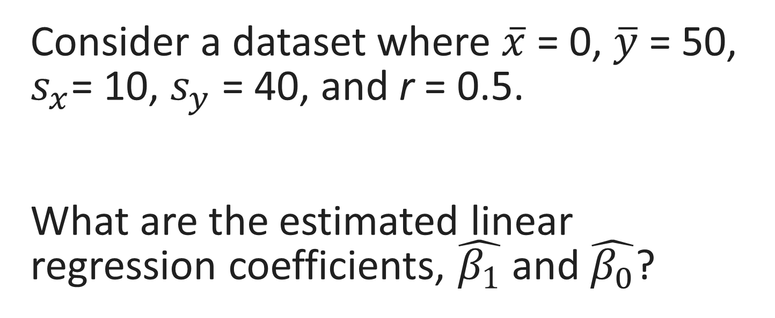
Unit 7: Linear Regression Intro
Consider a dataset where $\overline{x}$ = 0, $\overline{y}$ = 50, $s_{x}$= 10, $s_{y}$ = 40, and r = 0.5.
What are the estimated linear regression coefficients, $\hat{β_{1}}$ and $\hat{β_{0}}$?
FA24

Slide 44
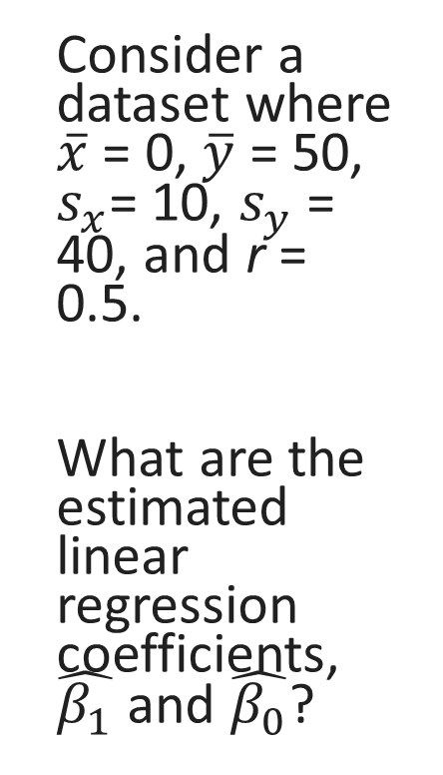

Unit 7: Linear Regression Intro
Consider a dataset where $\overline{x}$ = 0, $\overline{y}$ = 50, $s_{x}$= 10, $s_{y}$ = 40, and r = 0.5.
What are the estimated linear regression coefficients, $\hat{β_{1}}$ and $\hat{β_{0}}$?
$$\hat{β_{1}}=r∗\frac{s_{y}}{s_{x}}$$
$$=0.5 ∗\frac{40}{10}$$
$$=2$$
$$\hat{β_{0}}=\overline{y}−\hat{β_{1}} ∗\overline{x}$$
$$=50 −2∗0$$
$$=50$$
FA24

Slide 45
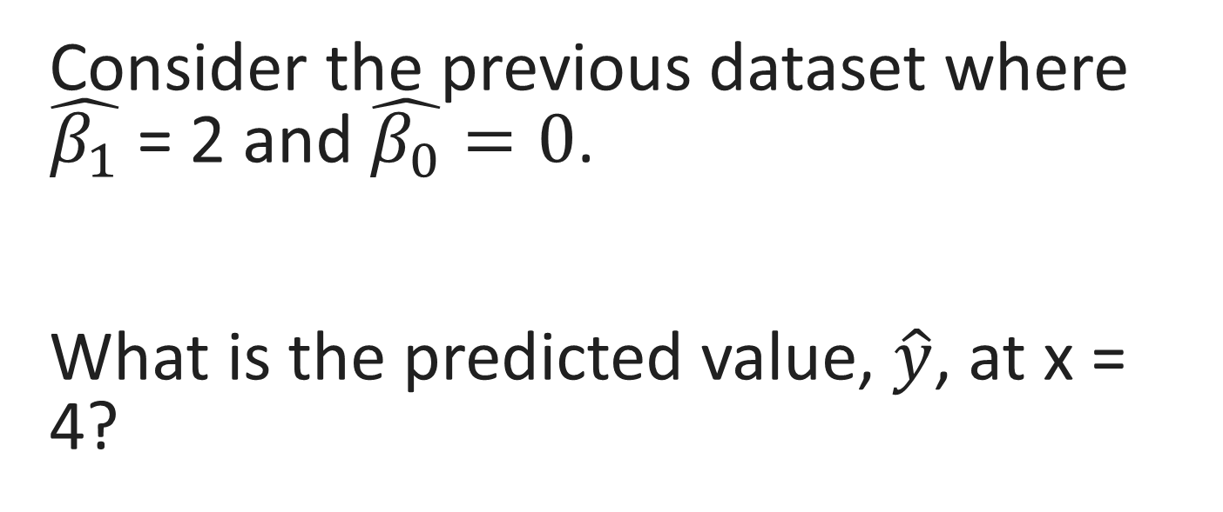
Unit 7: Linear Regression Intro
Consider the previous dataset where $\hat{β_{1}}$ = 2 and $\hat{β_{0}}=0$.
What is the predicted value, $\hat{y}$, at x = 4?
FA24

Slide 46
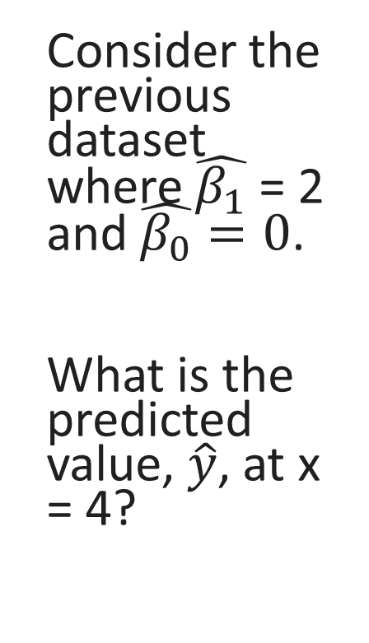
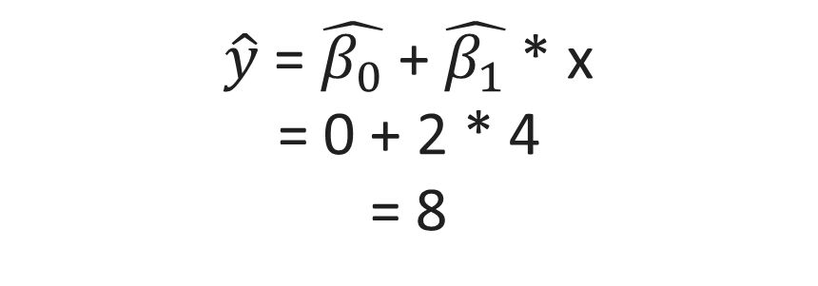
Unit 7: Linear Regression Intro
Consider the previous dataset where $\hat{β_{1}}$ = 2 and $\hat{β_{0}}=0$.
What is the predicted value, $\hat{y}$, at x = 4?
$\hat{y}$ = $\hat{β_{0}}$ + $\hat{β_{1}}$ * x
= 0 + 2 * 4
= 8
FA24

Slide 47
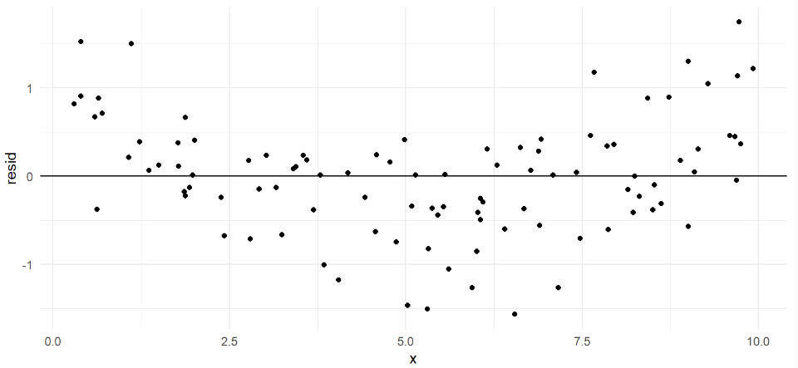
Unit 7: Linear Regression Intro
Which, if any, of the linear regression assumptions are violated in the plot below?
FA24

Slide 48
Unit 7: Linear Regression Intro
Linearity is violated; there is a clear curve pattern.
FA24

Slide 49
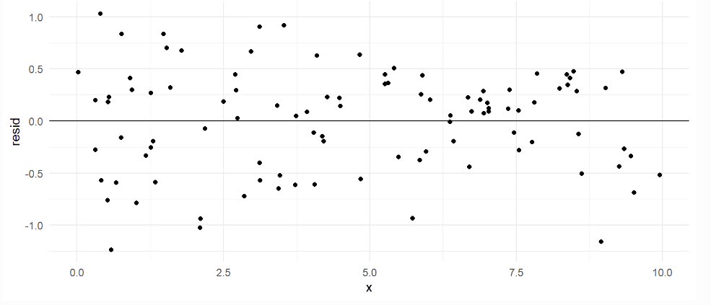
Unit 7: Linear Regression Intro
Which, if any, of the linear regression assumptions are violated in the plot below?
FA24

Slide 50
Unit 7: Linear Regression Intro
All assumptions are satisfied. There is no curve, the residuals seem normally distributed around the line, and there is no obvious spreading out or in.
FA24

Slide 51
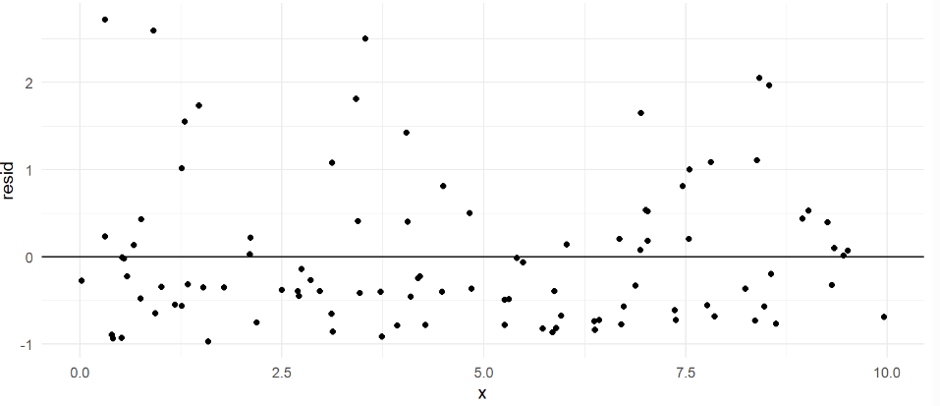
Unit 7: Linear Regression Intro
Which, if any, of the linear regression assumptions are violated in the plot below?
FA24

Slide 52
Unit 7: Linear Regression Intro
Normal errors around 0 is violated; the residuals are not symmetric, they are skewed positive.
FA24

Slide 53
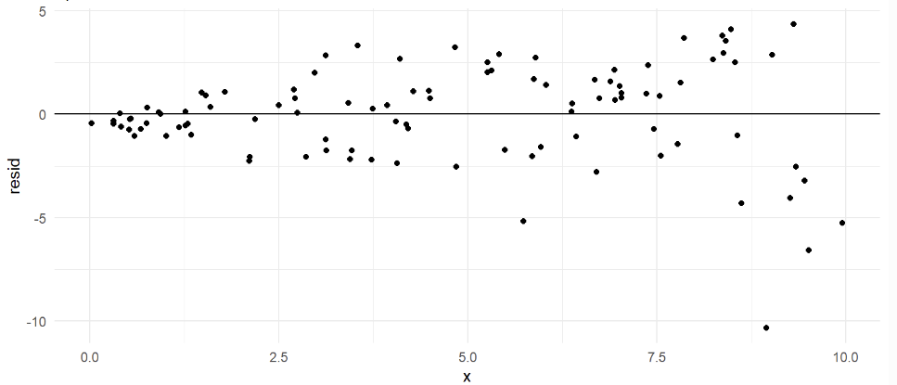
Unit 7: Linear Regression Intro
Which, if any, of the linear regression assumptions are violated in the plot below?
FA24

Slide 54
Unit 7: Linear Regression Intro
Constant variance is violated; the points fan out as you move right.
FA24

Slide 55
Unit 8: Linear Regression Inference

Slide 56
Unit 8: Linear Regression Inference
The following slides will take us through an example of linear regression inference. The dataset women is built into R, and contains heights and weights for a random sample of 15 American women in their 30’s. We wish to test for the existence of a relationship between height (input) and weight (response).
FA24

Slide 57
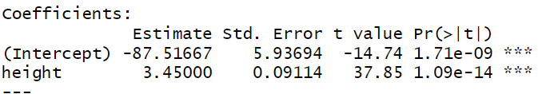
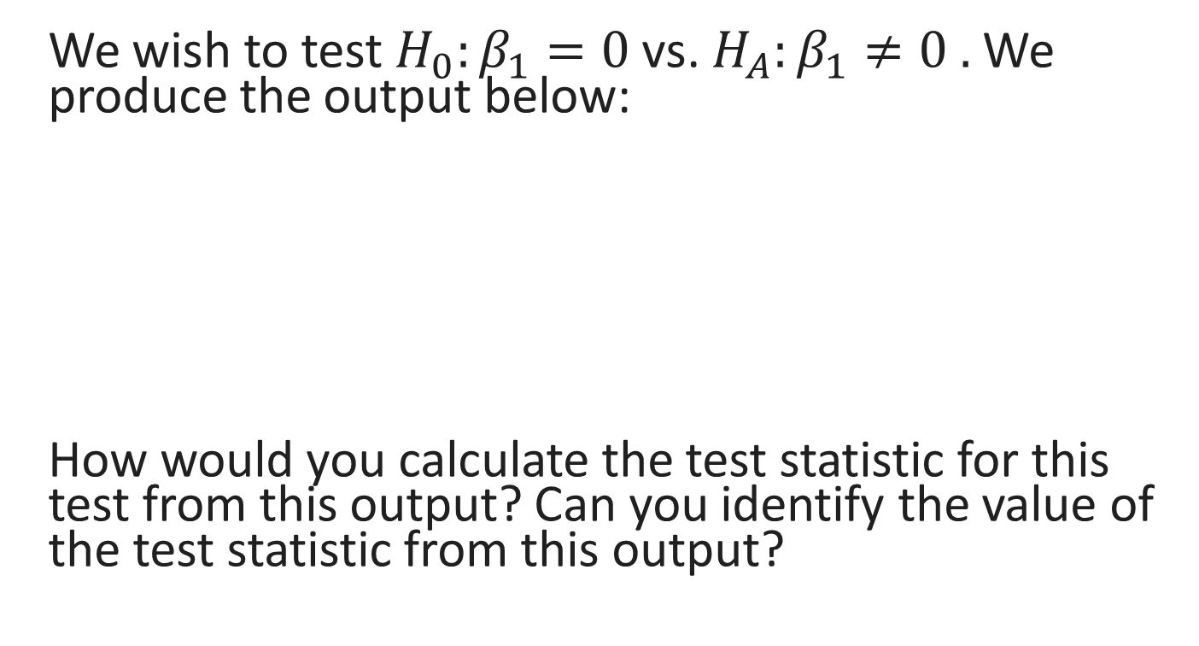
Unit 8: Linear Regression Inference
We wish to test $H_{0}:β_{1}=0$vs. $H_{A}:β_{1}≠0 .$ We produce the output below:
How would you calculate the test statistic for this test from this output? Can you identify the value of the test statistic from this output?
FA24

Slide 58
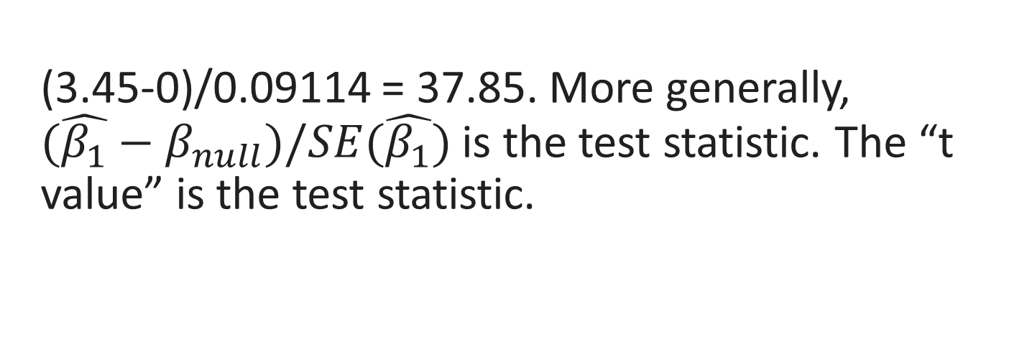
Unit 8: Linear Regression Inference
(3.45-0)/0.09114 = 37.85. More generally, ${(\hat{β_{1}}−β}_{null})/SE(\hat{β_{1}})$ is the test statistic. The “t value” is the test statistic.
FA24

Slide 59
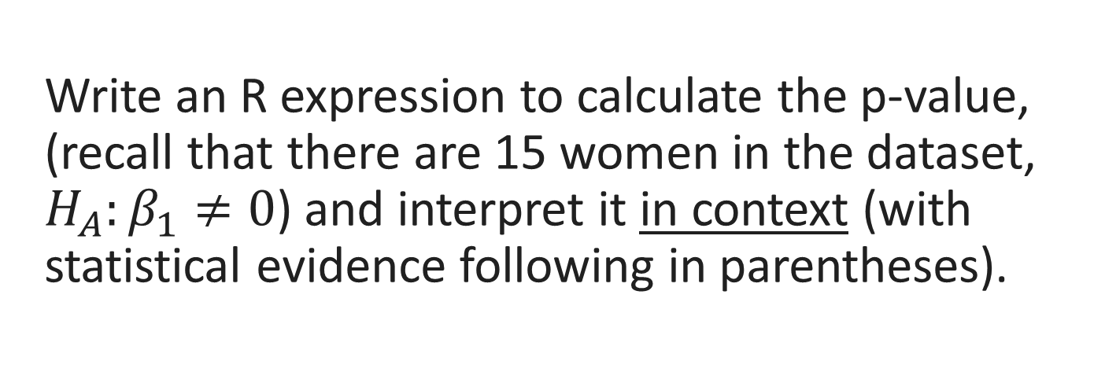
Unit 8: Linear Regression Inference
Write an R expression to calculate the p-value, (recall that there are 15 women in the dataset, $H_{A}:β_{1}≠0$) and interpret it in context (with statistical evidence following in parentheses).
FA24

Slide 60
Unit 8: Linear Regression Inference
2*(1-pt(37.85, df = 15-2))
2* because we have a two-tailed test; 1- because we need area to the right of 37.85 (which then gets doubled).
We find strong evidence for a relationship between height and weight among American women in their 30s (p = 1.09e-14, linear regression).
FA24

Slide 61
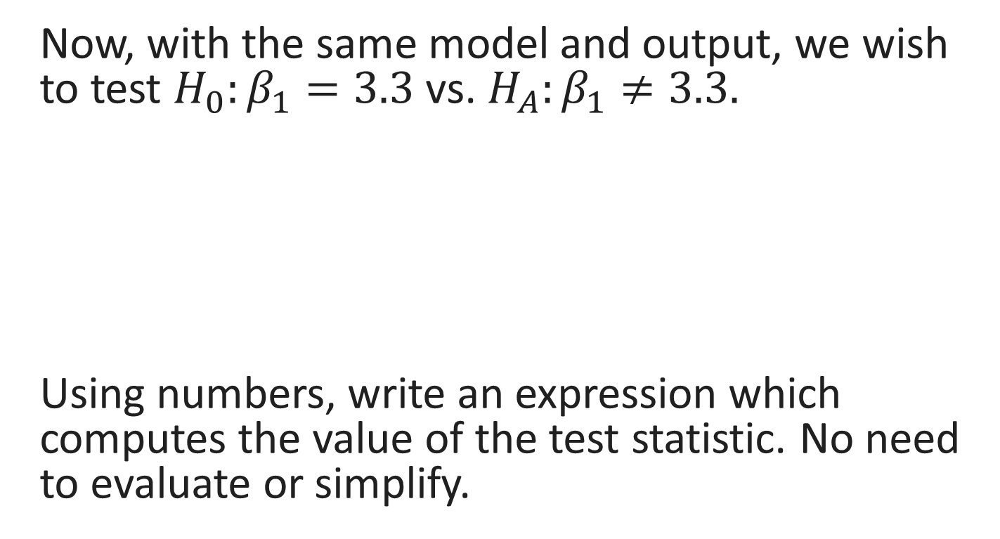
Unit 8: Linear Regression Inference
Now, with the same model and output, we wish to test $H_{0}:β_{1}=3.3$vs. $H_{A}:β_{1}≠3.3.$
Using numbers, write an expression which computes the value of the test statistic. No need to evaluate or simplify.
FA24

Slide 62

Unit 8: Linear Regression Inference
(3.45-3.3)/0.09114. More generally, ${(\hat{β_{1}}−β}_{null})/SE(\hat{β_{1}})$ is the test statistic.
FA24

Slide 63
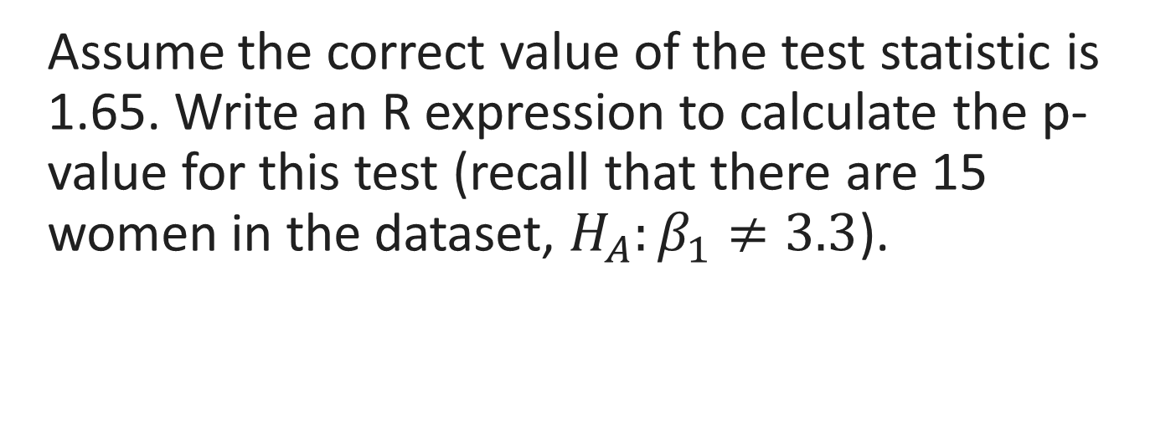
Unit 8: Linear Regression Inference
Assume the correct value of the test statistic is 1.65. Write an R expression to calculate the p-value for this test (recall that there are 15 women in the dataset, $H_{A}:β_{1}≠3.3$).
FA24

Slide 64
Unit 8: Linear Regression Inference
2*(1-pt(1.65, df = 15-2))
2* because we have a two-tailed test; 1- because we need area to the right of 37.85 (which then gets doubled).
Could also use 2 * pt(1.65, df = 13, lower.tail = FALSE).
FA24

Slide 65
Unit 8: Linear Regression Inference
Assume the correct p-value evaluates to 0.12. Using alpha = 0.05, interpret the p-value in context (followed by statistical evidence in parentheses).
FA24

Slide 66
Unit 8: Linear Regression Inference
We fail to find evidence that the true slope of the line relating the height and weight of American women in their 30s is different than 3.3. (p = 0.12, two-tailed linear regression test)
FA24

Slide 67
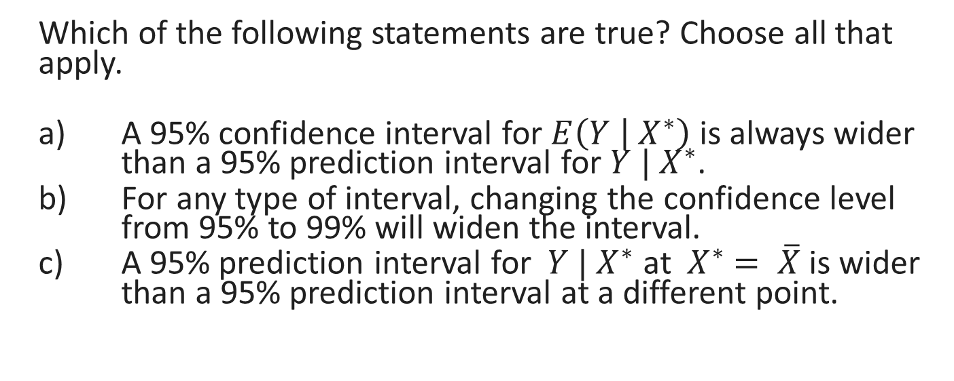
Unit 8: Linear Regression Inference
Which of the following statements are true? Choose all that apply.
A 95% confidence interval for $E\left(Y | { X}^{∗}\right)$ is always wider than a 95% prediction interval for $Y | X^{∗}$.
For any type of interval, changing the confidence level from 95% to 99% will widen the interval.
A 95% prediction interval for ${ Y | X}^{∗}$at ${ X}^{∗} = \overline{X}$ is wider than a 95% prediction interval at a different point.
FA24

Slide 68
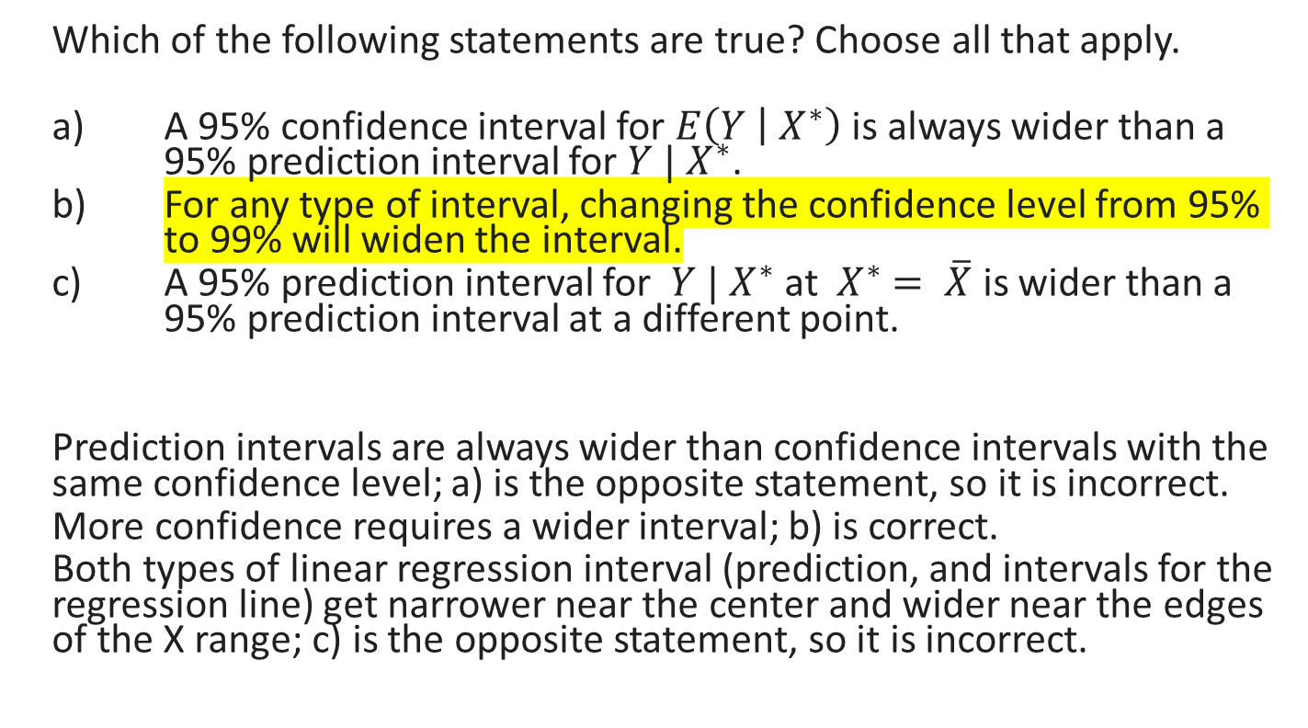
Unit 8: Linear Regression Inference
Which of the following statements are true? Choose all that apply.
A 95% confidence interval for $E\left(Y | { X}^{∗}\right)$ is always wider than a 95% prediction interval for $Y | X^{∗}$.
For any type of interval, changing the confidence level from 95% to 99% will widen the interval.
A 95% prediction interval for ${ Y | X}^{∗}$at ${ X}^{∗} = \overline{X}$ is wider than a 95% prediction interval at a different point.
Prediction intervals are always wider than confidence intervals with the same confidence level; a) is the opposite statement, so it is incorrect.
More confidence requires a wider interval; b) is correct.
Both types of linear regression interval (prediction, and intervals for the regression line) get narrower near the center and wider near the edges of the X range; c) is the opposite statement, so it is incorrect.
FA24

Slide 69
Unit 9: Inference on Proportions

Slide 70
Unit 9: Inference on Proportions
The following slides will take us through an example hypothesis test and then confidence interval for a difference in proportions on some made-up data.
Question of interest: Is there a difference in the proportion of people who are left-handed among basketball players and non-players?
FA24

Slide 71

Unit 9: Inference on Proportions
Made-up data from a random sample of basketball players and non-players:
Let $p_{player}$ be the true but unknown proportion of lefties among players and $p_{non}$ the proportion among non-players.
State the model for this scenario.
 | Left-Handed | Total
Basketball Players | 49 | 538
Non-Players | 64 | 500
FA24

Slide 72

Unit 9: Inference on Proportions
 | Left-Handed | Total
Basketball Players | 49 | 538
Non-Players | 64 | 500
$$X_{player}\sim Binom\left(538, p_{player}\right)$$
$$X_{non}\sim Binom(500, p_{non})$$
…where $X_{player}$ is a random variable representing the number of lefties in our random sample of players, $X_{non}$ for non-players.
FA24

Slide 73
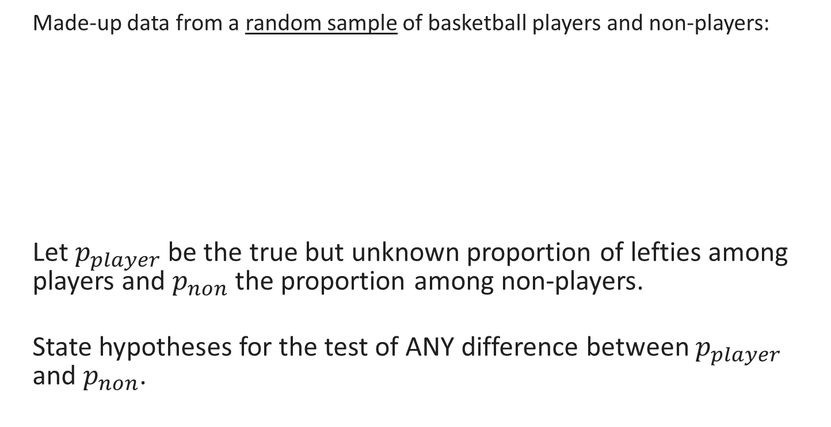
Unit 9: Inference on Proportions
Made-up data from a random sample of basketball players and non-players:
Let $p_{player}$ be the true but unknown proportion of lefties among players and $p_{non}$ the proportion among non-players.
State hypotheses for the test of ANY difference between $p_{player}$ and $p_{non}$.
 | Left-Handed | Total
Basketball Players | 49 | 538
Non-Players | 64 | 500
FA24

Slide 74
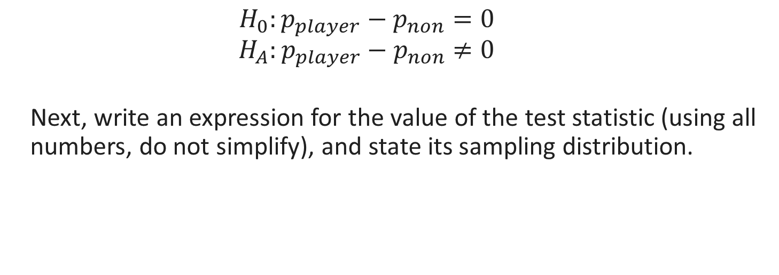
Unit 9: Inference on Proportions
 | Left-Handed | Total
Basketball Players | 49 | 538
Non-Players | 64 | 500
$$H_{0}:p_{player}−p_{non}=0$$
$$H_{A}:p_{player}−p_{non}≠0$$
Next, write an expression for the value of the test statistic (using all numbers, do not simplify), and state its sampling distribution.
FA24

Slide 75

Unit 9: Inference on Proportions
 | Left-Handed | Total
Basketball Players | 49 | 538
Non-Players | 64 | 500
$$z= \frac{\frac{49}{538}−\frac{64}{500}−0}{SE}\sim N(0,1)$$
$$SE= \sqrt{\frac{\overline{p}(1−\overline{p})}{538}+\frac{\overline{p}(1−\overline{p})}{500}}$$
$$\overline{p}=\frac{49+64}{538+500}$$
FA24

Slide 76

Unit 9: Inference on Proportions
 | Left-Handed | Total
Basketball Players | 49 | 538
Non-Players | 64 | 500
Assume the correct value of the test statistic from the previous question is -1.91. Write out R code which would compute the p-value for this test ($H_{A}:p_{player}−p_{non}≠0$).
FA24

Slide 77
Unit 9: Inference on Proportions
2*pnorm(-1.91)
Why 2*? Because the alternative hypothesis is that the true parameter is not equal to 0, so extremes in either direction from the sampling distribution are evidence for it, and the normal distribution is symmetric so the left tail and right tail will have equal area.
Why not 1- or lower.tail = FALSE? We would need that if the observed value of the test statistic was positive, so we could calculate area to its right and double that. However, it is negative, so we calculate area to its left (which is what pnorm does by default) and double that.
FA24

Slide 78
Unit 9: Inference on Proportions
Assume the correct p-value is 0.006. (It’s not, but pretend it is for this practice problem.) Using alpha = 0.05, interpret this p-value in context, with statistical evidence briefly included in parentheses at the end.
FA24

Slide 79
Unit 9: Inference on Proportions
We find strong evidence that the true proportion of lefties is different among basketball players and non-players. (p = 0.006, two-sided test for difference in proportions)
(DO NOT WRITE: “We reject the null hypothesis.” While this is true, it is not in context.)
FA24

Slide 80

Unit 9: Inference on Proportions
 | Left-Handed | Total
Basketball Players | 49 | 538
Non-Players | 64 | 500
Write out an expression for a 95% confidence interval for $p_{player}−p_{non}$ with the Agresti-Coffe adjustment. Include an R expression to calculate the critical value exactly.
FA24

Slide 81
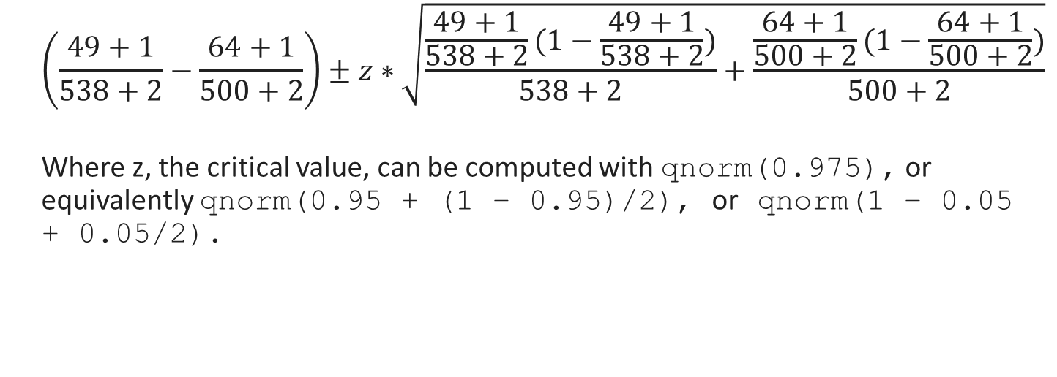
Unit 9: Inference on Proportions
 | Left-Handed | Total
Basketball Players | 49 | 538
Non-Players | 64 | 500
$$\left(\frac{49+1}{538+2}−\frac{64+1}{500+2}\right)±z∗\sqrt{\frac{\frac{49+1}{538+2}(1−\frac{49+1}{538+2})}{538+2}+\frac{\frac{64+1}{500+2}(1−\frac{64+1}{500+2})}{500+2}}$$
Where z, the critical value, can be computed with qnorm(0.975), or equivalently qnorm(0.95 + (1 – 0.95)/2), or qnorm(1 – 0.05 + 0.05/2).
FA24

Slide 82
Unit 10: Inference on Means

Slide 83
Unit 10: Inference on Means
The following slides will take us through an example hypothesis test and then confidence interval for a difference in means on some made-up data.
Question of interest: Is there evidence the true average height (in inches) of corn plants given a special growth treatment is GREATER than that of corn plants given water?
FA24

Slide 84
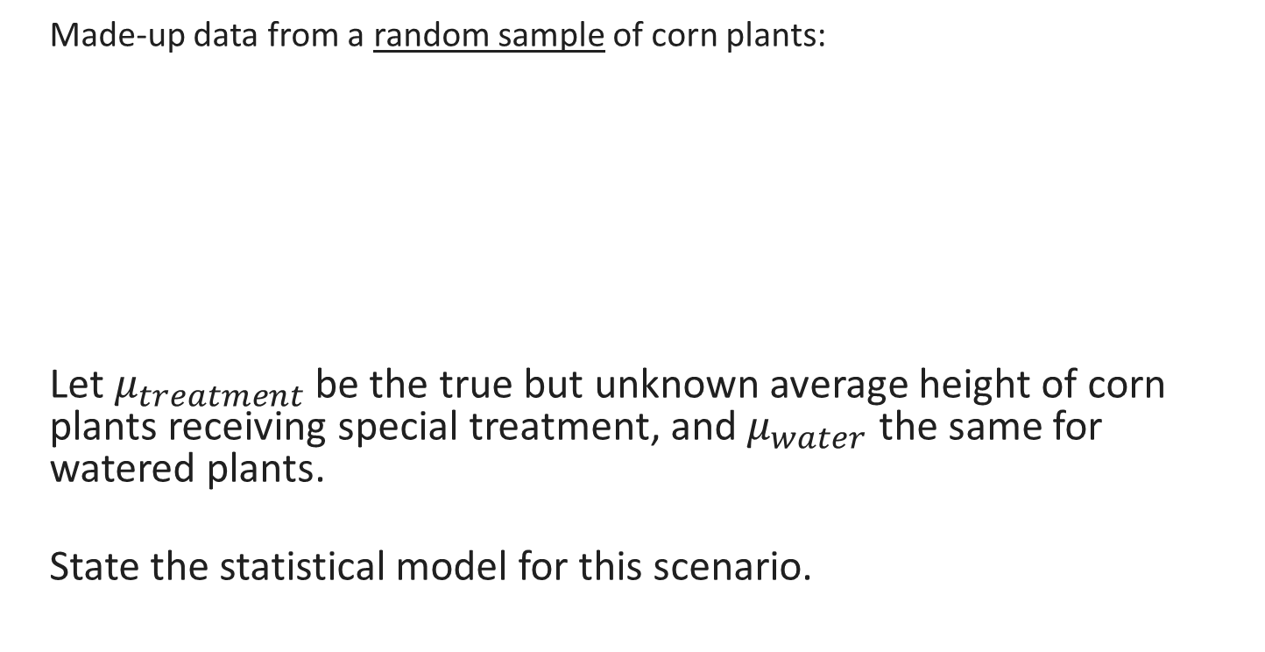
Unit 10: Inference on Means
Made-up data from a random sample of corn plants:
Let $μ_{treatment}$ be the true but unknown average height of corn plants receiving special treatment, and$μ_{water}$ the same for watered plants.
State the statistical model for this scenario.
 | Average | Std. Dev | N
Special Treatment | 84.2 | 4.2 | 14
Water | 80.8 | 3.4 | 13
FA24

Slide 85
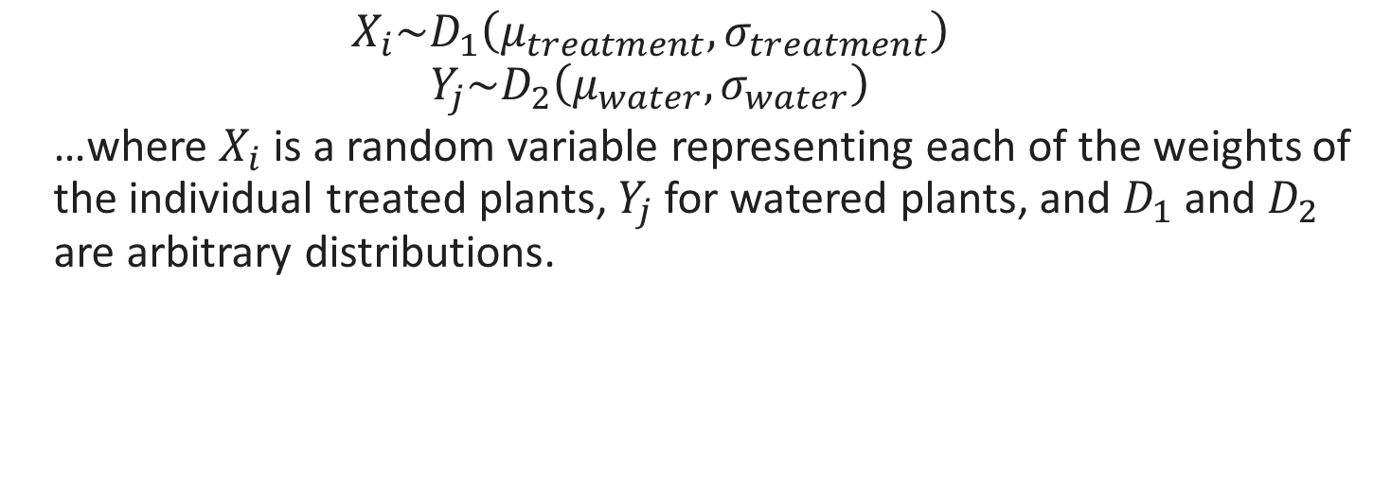
Unit 10: Inference on Means
 | Average | Std. Dev | N
Special Treatment | 84.2 | 4.2 | 14
Water | 80.8 | 3.4 | 13
$$X_{i}\sim D_{1}\left(μ_{treatment}, σ_{treatment}\right)$$
$$Y_{j}\sim D_{2}\left(μ_{water}, σ_{water}\right)$$
…where $X_{i}$ is a random variable representing each of the weights of the individual treated plants, $Y_{j}$ for watered plants, and $D_{1}$ and $D_{2}$ are arbitrary distributions.
FA24

Slide 86
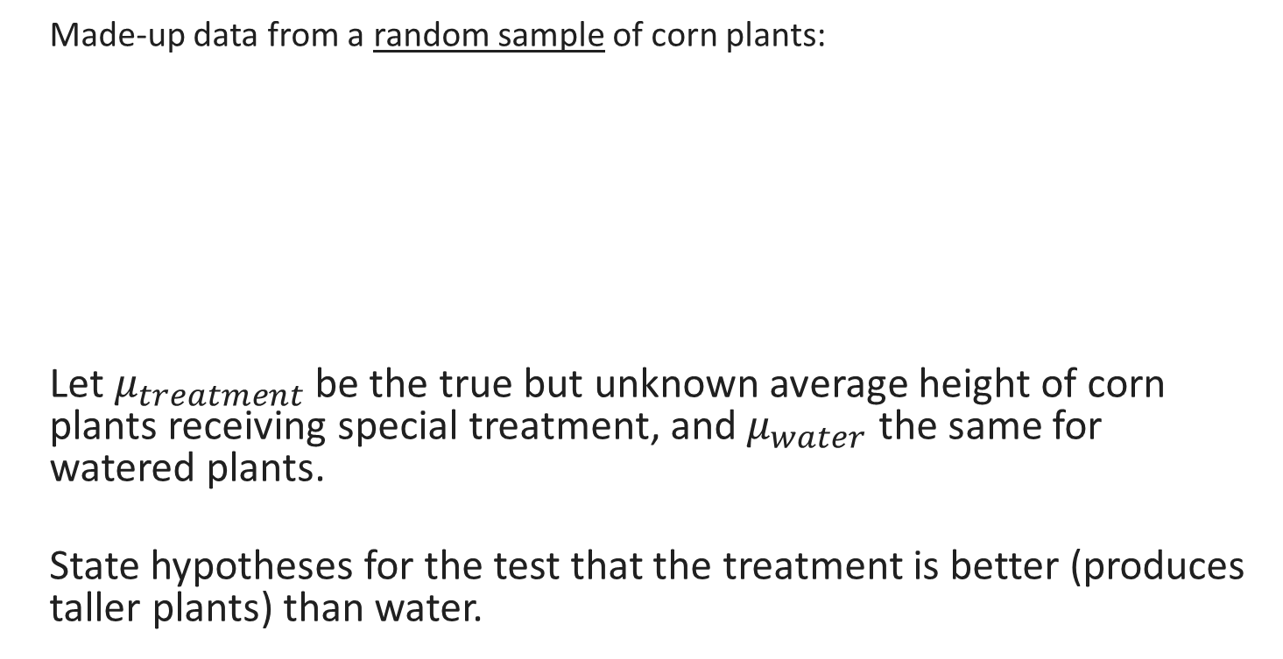
Unit 10: Inference on Means
Made-up data from a random sample of corn plants:
Let $μ_{treatment}$ be the true but unknown average height of corn plants receiving special treatment, and$μ_{water}$ the same for watered plants.
State hypotheses for the test that the treatment is better (produces taller plants) than water.
 | Average | Std. Dev | N
Special Treatment | 84.2 | 4.2 | 14
Water | 80.8 | 3.4 | 13
FA24

Slide 87

Unit 10: Inference on Means
 | Average | Std. Dev | N
Special Treatment | 84.2 | 4.2 | 14
Water | 80.8 | 3.4 | 13
$$H_{0}:μ_{treatment}−μ_{water}=0$$
$$H_{A}:μ_{treatment}−μ_{water}>0$$
FA24

Slide 88
Unit 10: Inference on Means
 | Average | Std. Dev | N
Special Treatment | 84.2 | 4.2 | 14
Water | 80.8 | 3.4 | 13
Next, write an expression for the value of the test statistic (using numbers, do not simplify).
FA24

Slide 89

Unit 10: Inference on Means
 | Average | Std. Dev | N
Special Treatment | 84.2 | 4.2 | 14
Water | 80.8 | 3.4 | 13
$$T=\frac{(84.2−80.8)−0}{\sqrt{\frac{{4.2}^{2}}{14}+\frac{{3.4}^{2}}{13}}}$$
FA24

Slide 90
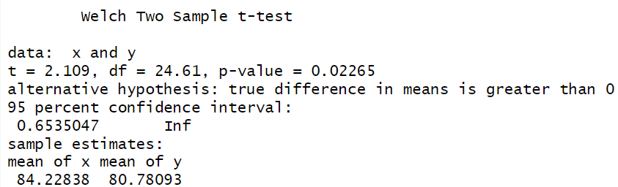
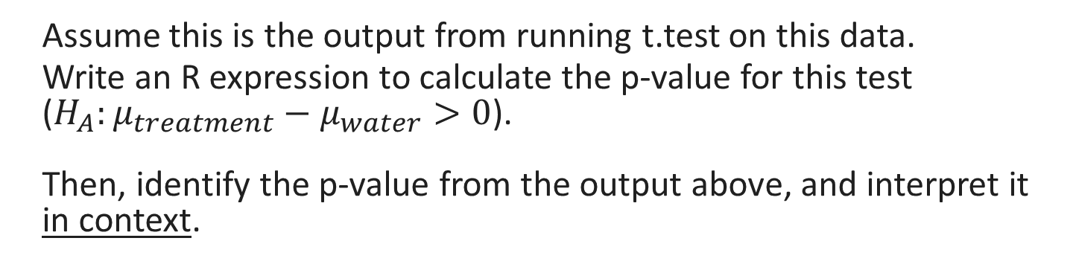
Unit 10: Inference on Means
Assume this is the output from running t.test on this data.
Write an R expression to calculate the p-value for this test ($H_{A}:μ_{treatment}−μ_{water}>0$). Then, identify the p-value from the output above, and interpret it in context.
FA24

Slide 91
Unit 10: Inference on Means
1-pt(2.109, df = 24.61)
Why not 2*? Because the alternative hypothesis was >, so we don’t take both tails, only the right extreme.
Why 1-? Because we want the area to the right of 2.109, which is positive, and pt() gives area to the left by default.
We find significant evidence that the special treatment increases the average weight of corn plants compared to water alone. (p = 0.02, one-sided test for difference in means)
FA24

Slide 92
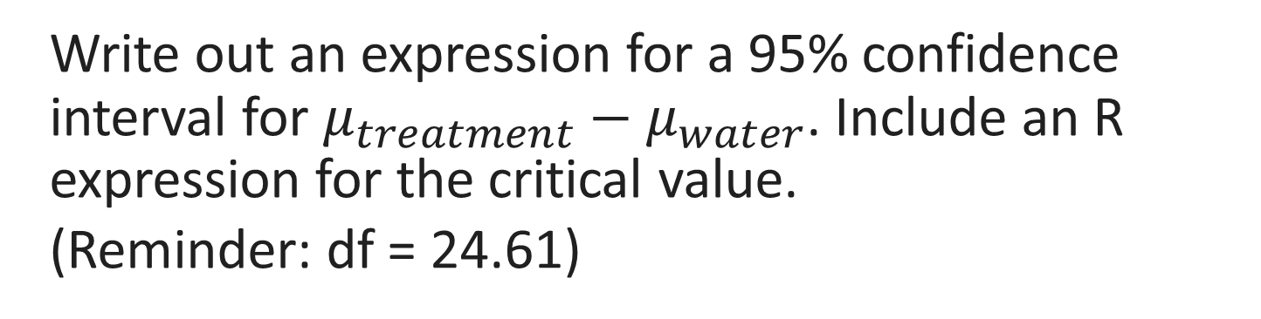
Unit 10: Inference on Means
 | Average | Std. Dev | N
Special Treatment | 84.2 | 4.2 | 14
Water | 80.8 | 3.4 | 13
Write out an expression for a 95% confidence interval for $μ_{treatment}−μ_{water}$. Include an R expression for the critical value.
(Reminder: df = 24.61)
FA24

Slide 93
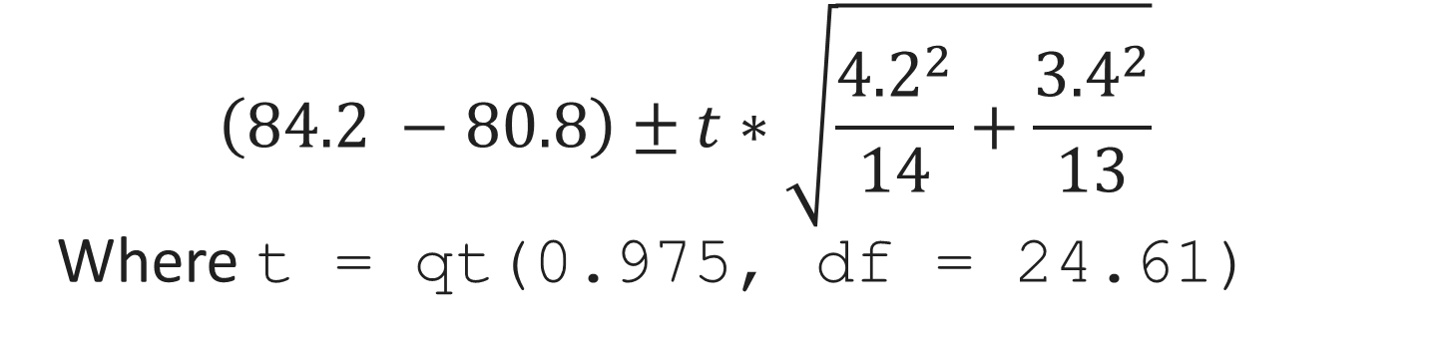
Unit 10: Inference on Means
 | Average | Std. Dev | N
Special Treatment | 84.2 | 4.2 | 14
Water | 80.8 | 3.4 | 13
$$\left(84.2 −80.8\right)±t∗\sqrt{\frac{{4.2}^{2}}{14}+\frac{{3.4}^{2}}{13}}$$
Where t = qt(0.975, df = 24.61)
FA24

